Slide 1

CFD preliminary analysis Case study - Palazzo Ducale (Venice – Italy)
Task 3.3 Multi-physical environmental Simulations of CH Exhibition Impacts (M3; M32)

Slide 2
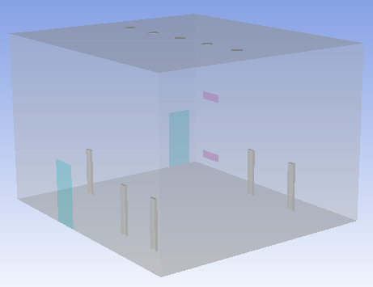
Case study - Palazzo Ducale Room geometry
Lighting (5 sources)
HVAC system
2 doors always open
6 m
5 persons
9 m
8 m

Slide 3
Case study - Palazzo Ducale Boundary conditions (summer’s day)
Ceiling
T 28 °C
Inlet Mass Flow Rate = 0,14 Kg/s
T = 16,6 °C
UR = 91 %
Q = 10 W/m² for unit
Outlet:
0 Pa
T =26 °C
UR = 62 %
0 Pa
T = 26 °C
UR = 62%
1 External wall (where there are HVAC inlet and outlet)
Q = 10.91 W/m²
The other walls are adiabatic
Floor
T 28 °C
Q = 70 W/m² for person

Slide 4
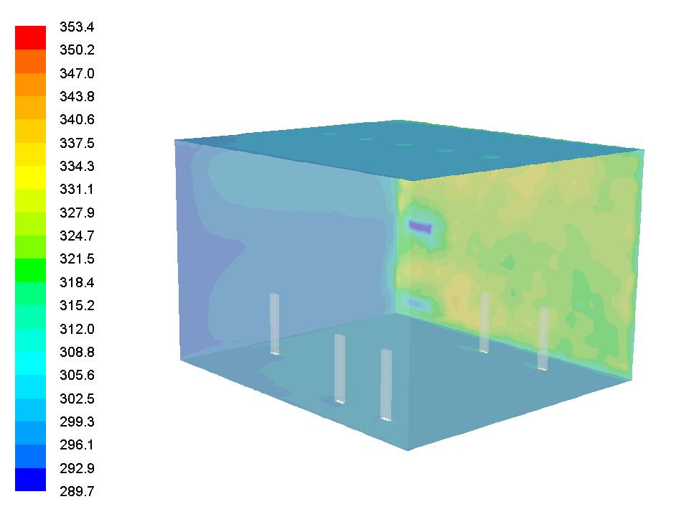
Case study - Palazzo Ducale Temperature contour (K)

Slide 5
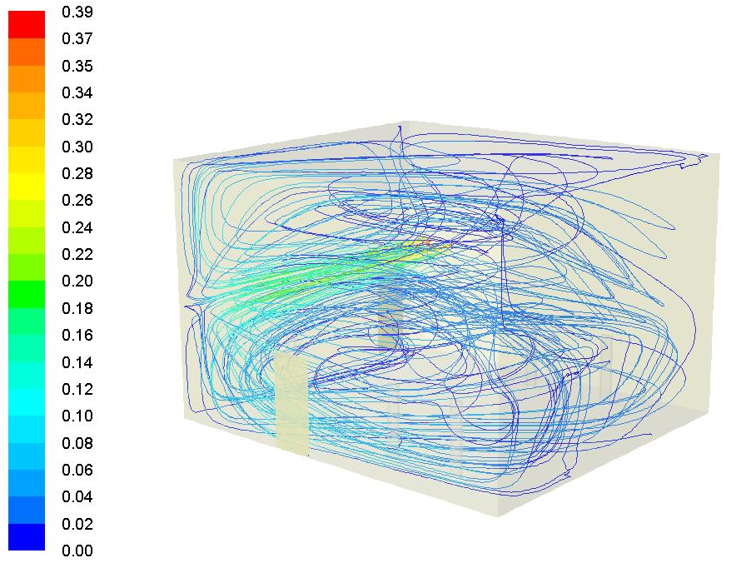
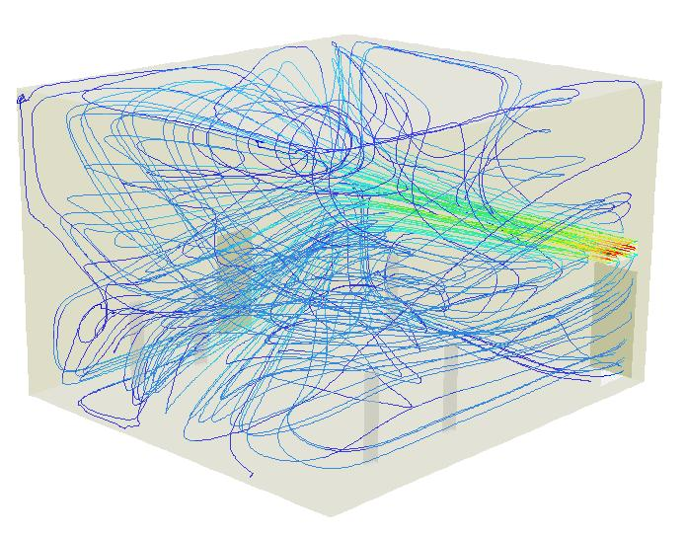
Case study - Palazzo Ducale Velocity pathlines (m/s)
Front view
Side view

